Slide 1


Salary predictor for cities
This is my city: how much should I earn?

Slide 2
Features considered - sources
Estimated Population (2017-07-01)
Land Area (2016-01-01)
US Census Bureau

Slide 3
Features considered - sources
Estimated Population (2017-07-01)
Land Area (2016-01-01)
Things to do tripadvisor.com
US Census Bureau

Slide 4
Features considered - sources
Estimated Population (2017-07-01)
Land Area (2016-01-01)
Things to do tripadvisor.com
Rent appartment apartmentlist.com
US Census Bureau

Slide 5
Features considered - sources
Estimated Population (2017-07-01)
Land Area (2016-01-01)
Things to do tripadvisor.com
Rent appartment apartmentlist.com
Murder rate
Assault rate
Median Income
US Census Bureau
city-data.com

Slide 6
Method
272 data points

Slide 7
Method
272 data points
Polynomials up to order 4

Slide 8
Method
272 data points
Polynomials up to order 4
Ridge, Lasso and Elastic Net with CV

Slide 9
Method
272 data points
Polynomials up to order 4
Ridge, Lasso and Elastic Net with CV
Mean square error of test as indicator

Slide 10
Method
272 data points
Polynomials up to order 4
Ridge, Lasso and Elastic Net with CV
Mean square error of test as indicator
Learning curves used to check overfitting

Slide 11
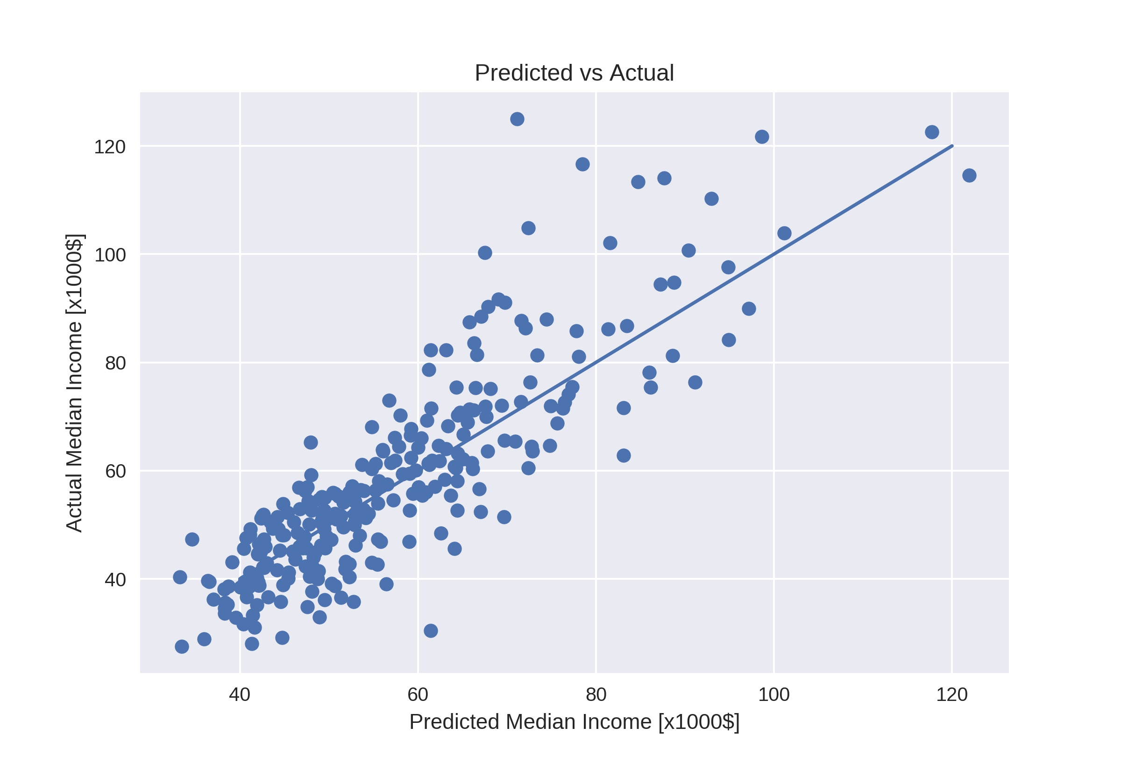
Our chosen model
Lasso regularization polynomial degree 2

Slide 12
Our chosen model
Lasso regularization polynomial degree 2

Slide 13
Influence of features
Population: high population - lower salaries

Slide 14
Influence of features
Population: high population - lower salaries
Area: large cities - higher salaries

Slide 15
Influence of features
Population: high population - lower salaries
Area: large cities - higher salaries
Things to do: interesting cities – higher salaries

Slide 16
Influence of features
Population: high population - lower salaries
Area: large cities - higher salaries
Things to do: interesting cities – higher salaries
Rent price: high rent – high salaries

Slide 17
Influence of features
Population: high population - lower salaries
Area: large cities - higher salaries
Things to do: interesting cities – higher salaries
Rent price: high rent – high salaries
Murders and Assaults: high crime – low salaries

Slide 18
Conclusion and outlook
Predictor works best for medium-low salaries

Slide 19
Conclusion and outlook
Predictor works best for medium-low salaries
Most important: things to do, rent prices and crime

Slide 20
Conclusion and outlook
Predictor works best for medium-low salaries
Most important: things to do, rent prices and crime
More features can be included in future models

Slide 21
Conclusion and outlook
Predictor works best for medium-low salaries
Most important: things to do, rent prices and crime
More features can be included in future models
Extension to cities around the world

Slide 22
Coefficients
Index(['Population', 'Area', 'Things_to_do', 'Rent', 'Murders', 'Assaults']
(array([0, 1, 0, 0, 0, 0]), 0.052979594815016046)
(array([0, 0, 1, 0, 0, 0]), 0.044577590978332485)
(array([0, 0, 0, 1, 0, 0]), 0.5456600637371769)
(array([0, 0, 0, 0, 1, 0]), -0.23546102272115763)
(array([0, 0, 0, 0, 0, 1]), -0.33686571267402315)
(array([2, 0, 0, 0, 0, 0]), -2.934867016329599e-05)
(array([1, 0, 1, 0, 0, 0]), -0.018717655497216764)
(array([0, 1, 0, 0, 0, 1]), 0.005620153999713671)
(array([0, 0, 2, 0, 0, 0]), 0.014118787982803794)
(array([0, 0, 1, 0, 1, 0]), 0.02642369251955364)
(array([0, 0, 0, 2, 0, 0]), -0.0258409705215245)
(array([0, 0, 0, 0, 0, 2]), 0.09101982517795179)

